Slide 1
Evolution of Operating Systems

Slide 2
Need for Evolution of an Operating Systems
Must adapt to hardware upgrades and new types of hardware
Must offer new services
Fixes – Any OS has faults
The need to change the OS on regular basis places certain requirements on it’s design:
modular construction with clean interfaces.
much more to be done than simple partitioning a program into modules - object oriented methodology.

Slide 3
Evolution of an Operating Systems
Early Systems/Serial Processing (mid 1940s to mid 1950s)
Simple Batch Systems (1960)
Multi-programmed Batch Systems (1970)
Time-Sharing and Real-Time Systems (1970)
Multiprocessor Systems (1980)
Networked/Distributed Systems (1980)

Slide 4

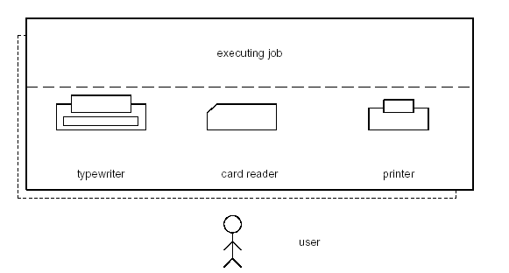

Early Systems/Serial Processing
A Programmer/User as operator interacted directly with the
hardware
Large machines run from console, since no OS
Programs in machine code are read through card reader

Slide 5
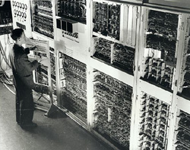
Example of an early computer system

Slide 6
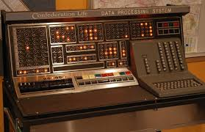
Early Systems /Serial Processing
Machines run from a console with display lights, toggle switches, input device, and printer
If no error, program output in printer, or else error indicated by lights
Extremely slow I/O devices
Very low CPU utilization

Slide 7

Early Systems /Serial Processing
Serial processing
Scheduling:
User should reserve computer time in hard copy sheet, in multiples of 30 minutes or so.
Overhead in scheduling time.
Setup included loading the compiler, source program, saving compiled program, and loading and linking
Need significant amount of setup time
in mounting and dismounting card decks
Various system software tools were developed to make
serial processing easier – linkers, loaders, debuggers and
I/O driver routines

Slide 8
Simple Batch Systems
Early computers were expensive - important to maximize CPU utilization
Scheduling and setup time was unacceptable
Jobs of users are batched together by an operator - submits the entire batch to the input device for use by the monitor.
After each job, the control branches back to the monitor, and the monitor automatically begins loading the next job for execution
A special program, the monitor, manages the execution of each program in the batch.
Monitor utilities are loaded when needed – compilers, assemblers, drivers...
“Resident monitor” is always in main memory and available for execution that controls the sequence of events

Slide 9
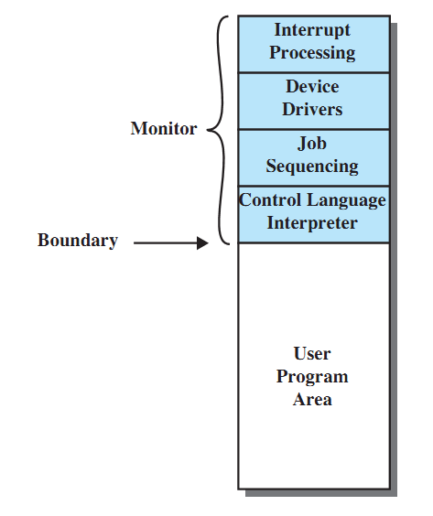
Resident Monitor Layout

Slide 10
Control Cards
Problems:
How does the monitor know about the nature of the job (e.g., Fortran versus Assembly) or which program to execute?
How does the monitor distinguish: (a) job from job? (b) data from program?
Solution: Job Control Language (JCL) and control cards.

Slide 11
Job Control Language (JCL)
$JOB
$FTN
...
FORTRAN
program
...
$LOAD
$RUN
...
Data
...
$END
JCL is the language that provides instructions
to the monitor:
what compiler to use
what data to use
Example of job format: ------->>
$FTN loads the FORTRAN compiler and transfers control to it.
$LOAD loads the object code (along in place of compiler).
$RUN transfers control to user program.

Slide 12
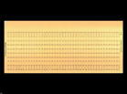
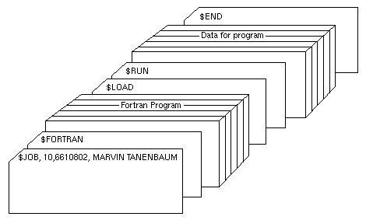
Example card deck of a Job

Slide 13
Idea of Simple Batch Systems
Reduce setup time by batching similar jobs.
Alternate execution between user program (user mode) and the monitor program (kernel mode).
Sacrifices:
some main memory is now given over to the monitor
some processor time is consumed by the monitor

Slide 14
Desirable Hardware Features
Memory protection
do not allow the memory area containing the monitor to be altered by a user program.
Privileged instructions
can be executed only by the resident monitor.
A trap occurs if a program tries these instructions.
Interrupts
provide flexibility for relinquishing control to and regaining control from user programs.
Timer interrupts prevent a job from monopolizing the system.

Slide 15
Spooling
Problem:
Card reader, Line printer and Tape drives slow (compared to Disk).
I/O and CPU could not overlap.
Solution: Spooling -
Overlap I/O of one job with the computation of another job (using double buffering, DMA, etc).
Technique is called SPOOLing: Simultaneous Peripheral Operation On Line.

Slide 16
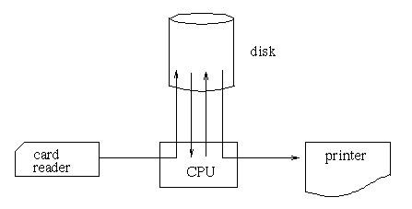
Spooling
While executing one job, the OS:
Reads next job from card reader into a storage area on the disk (Job pool).
Outputs printout of previous job from disk to printer.
Job pool – data structure that allows the OS to select which job to run next in order to increase CPU utilization.

Slide 17
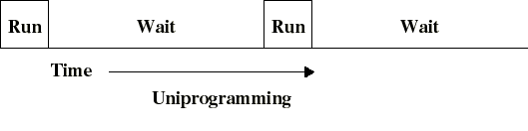
Uni-programming until now
I/O operations are exceedingly slow (compared to instruction execution).
A program containing even a very small number of I/O operations, will spend most of its time waiting for them.
Hence: poor CPU usage when only one program is present in memory.

Slide 18
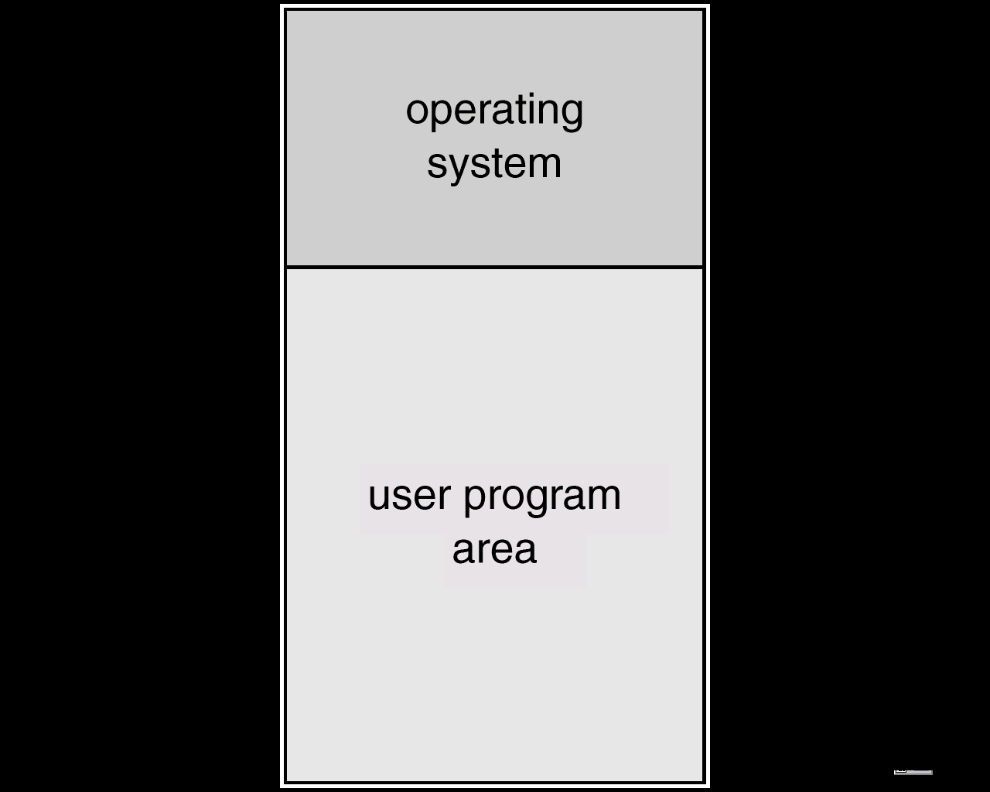
Memory Layout for Uni-programming

Slide 19
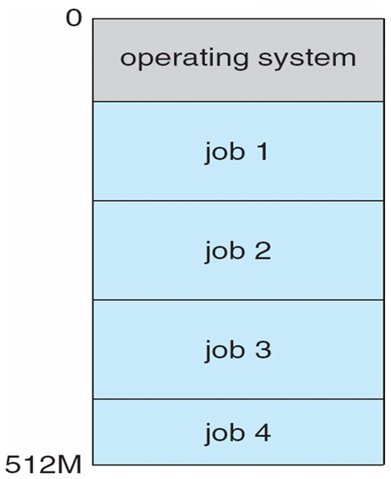
Memory Layout for Batch Multiprogramming
Several jobs are kept in main memory at the same time, and the CPU is multiplexed among them.

Slide 20
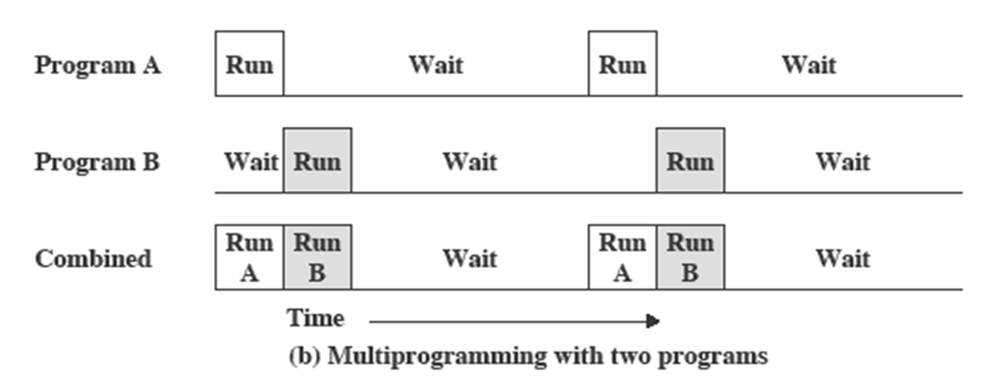
Multiprogramming
There must be enough memory to hold the OS (resident monitor) and one user program
When one job needs to wait for I/O, the processor can switch to the other job, which is likely not waiting for I/O

Slide 21
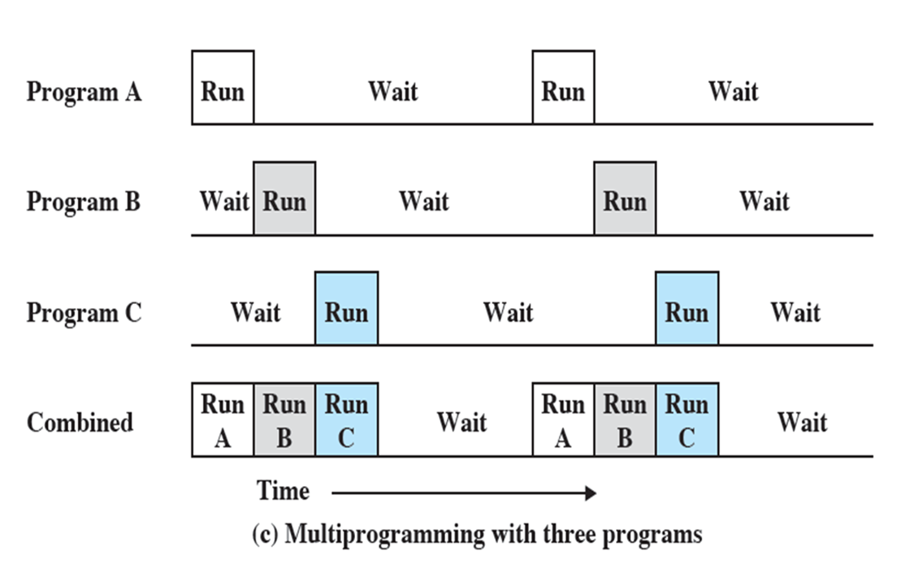
Multiprogramming
Multiprogramming
also known as multitasking
memory is expanded to hold three, four, or more programs and switch among all of them

Slide 22
Why Multiprogramming?
Multiprogramming needed for efficiency:
Single user cannot keep CPU and I/O devices busy at all times.
Multiprogramming organizes jobs (code and data) so CPU always has one to execute.
A subset of total jobs in system is kept in memory.
One job selected and run via job scheduling.
When it has to wait (for I/O for example), OS switches to another job.

Slide 23
Requirements for Multiprogramming
Hardware support:
I/O interrupts and DMA controllers
in order to execute instructions while I/O device is busy.
Timer interrupts for CPU to gain control.
Memory management
several ready-to-run jobs must be kept in memory.
Memory protection (data and programs).
Software support from the OS:
For scheduling (which program is to be run next).
To manage resource contention.

Slide 24
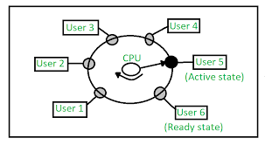
Time-Sharing Systems
Can be used to handle multiple interactive jobs
Processor time is shared among multiple users
Multiple users simultaneously access the system through terminals, with the OS interleaving the execution of each user program in a short CPU burst or time quantum of computation

Slide 25
Compatible Time-Sharing Systems CTSS
One of the first time-sharing operating systems
Developed at MIT by a group known as Project MAC
Ran on a computer with 32,000 36-bit words of main memory, with the resident monitor consuming 5000 of that
To simplify both the monitor and memory management a program was always loaded to start at the location of the 5000th word

Slide 26
Time Slicing
System clock generates interrupts at a rate of approximately once every 0.2 seconds
At each interrupt OS regained control and could assign processor to another user
At regular time intervals the current user would be preempted and another user loaded in
Old user programs and data were written out to disk
Old user program code and data were restored in main memory when that program was next given a turn

Slide 27
CTSS Operation

Slide 28
Real-time Operating Systems
Real-time operating system (RTOS) is an operating system intended to serve real time application that process data as it comes in, mostly without buffer delay.
It is time-bound system that can be defined as fixed time constraints.
In this type of system, processing must be done inside the specified constraints. Otherwise, the system will fail.

Slide 29
Real-time Systems
Three types of RTOS systems are:
Hard Real Time :
In Hard RTOS, the deadline is handled very strictly which means that given task must start executing on specified scheduled time, and must be completed within the assigned time duration.
Example: Medical critical care system, Aircraft systems, etc.

Slide 30
Real-time Systems
Firm Real time:
These type of RTOS also need to follow the deadlines. However, missing a deadline may not have big impact but could cause undesired affects, like a huge reduction in quality of a product.
Example: Various types of Multimedia applications.
Soft Real Time:
Soft Real time RTOS, accepts some delays by the Operating system. In this type of RTOS, there is a deadline assigned for a specific job, but a delay for a small amount of time is acceptable. So, deadlines are handled softly by this type of RTOS.
Example: Online Transaction system and Livestock price quotation System.

Slide 31
Real-time Systems
Real-time systems are used in:
Airlines reservation system.
Air traffic control system.
Systems that need immediate updating.
Used in any system that provides up to date and minute information on stock prices.
Defense application systems like RADAR.
Networked Multimedia Systems
Command Control Systems

Slide 32
Multi-processor Systems
Multiprocessor Operating System refers to the use of two or more central processing units (CPU) within a single computer system.
These multiple CPUs are in a close communication sharing the computer bus, memory and other peripheral devices.
These systems are referred as tightly coupled systems.
These types of systems are used when very high speed is required to process a large volume of data.
These systems are generally used in environment like satellite control, weather forecasting etc.

Slide 33
Multi-processor Systems
Symmetric Multiprocessors
In these types of systems, each processor contains a similar copy of the operating system and they all communicate with each other. All the processors are in a peer to peer relationship i.e. no master - slave relationship exists between them.
An example of the symmetric multiprocessing system is the Encore version of Unix for the Multimax Computer.

Slide 34
Multi-processor Systems
Asymmetric Multiprocessors
In asymmetric systems, each processor is given a predefined task. There is a master processor that gives instruction to all the other processors. Asymmetric multiprocessor system contains a master slave relationship.
Asymmetric multiprocessor was the only type of multiprocessor available before symmetric multiprocessors were created.

Slide 35
Distributed Operating Systems
A DOS is a system which contains multiple components located on different machines, which coordinate and communicate actions in order to appear as a single coherent working system to the user.
A distributed operating system (DOS), are systems which model where distributed applications are running on multiple computers, linked by communications.
All software and hardware compounds are located remotely. In order for them to communicate with each other, they pass messages.

Slide 36
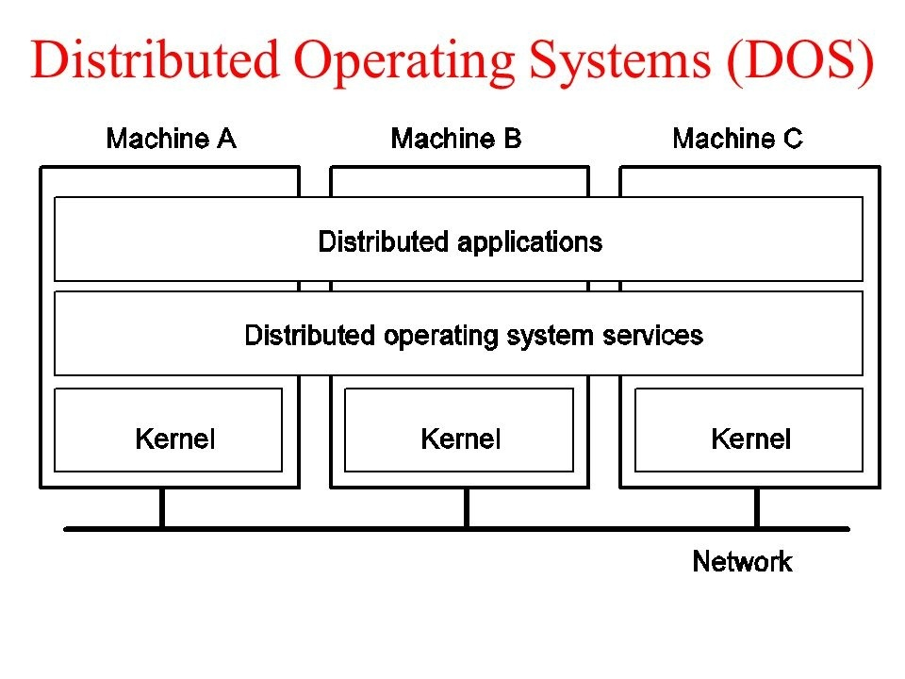

Slide 37
Network Operating System
Network Operating System is an operating system that includes special functions for connecting computers and devices into a local-area network (LAN) or Inter-network.
Some popular network operating systems are Novell Netware, Windows NT/2000, Linux, Sun Solaris, UNIX, and IBM OS/2.
An operating system that provides the connectivity among a number of autonomous computers is called a network operating system.
A typical configuration for a network operating system is a collection of personal computers along with a common printer, server and file server for archival storage, all tied together by a local network.

Slide 38
Network Operating System
Provide file, print, web services and back-up services.
Support Internet working such as routing and WAN ports.
User management and support for logon and logoff, remote access; system management, administration and auditing tools with graphical interfaces.
In this, the users can remotely access each other.
It also includes security features.
Example: authentication of data, restrictions on required data, authorizations of users etc.

Slide 39
Homework
Clustered Systems
Peer-Peer Systems
Mobile Computing Systems
Web/Cloud-based Systems

